Slide 1
Bela
Sound
Mangler
Designed by Mitchell McDermott

Slide 2
What is Bela Sound Mangler?
Simple, intuitive, chaotic tool for sound exploration
Record and playback samples
Pitch shift, robotise, reverse, slow down, chop sound via Trill Sensor
Bela Mini
Phase Vocoder

Slide 3
Why is Bela Sound Mangler?
Initial idea unobtainable within confines of project
Bridge the gap between studies of DSP principles and programming knowledge
Inspired by oddity
Simple to use
Anybody can play it

Slide 4
Software Description
Multi-threading for FFT Processing and Write functions
If statements for switching program modes and functions
Trill Sensor to manipulate FFT Processing Effects and Audio Playback Manipulation
GUI Sensor to control functions not covered by Trill Sensor
Audio Input and Output
FFT Processing
Robotisation
Whipserisation
Pitch Scaling
Audio Playback Manipulation
Slow speed
Reverse
Change loop length

Slide 5
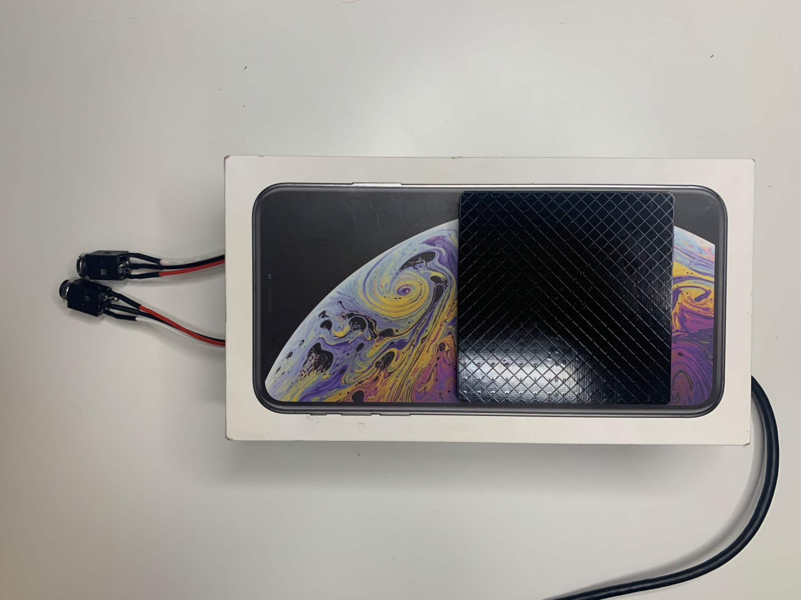
Device Configuration
Trill Sensor
Input
Output
USB Port

Slide 6
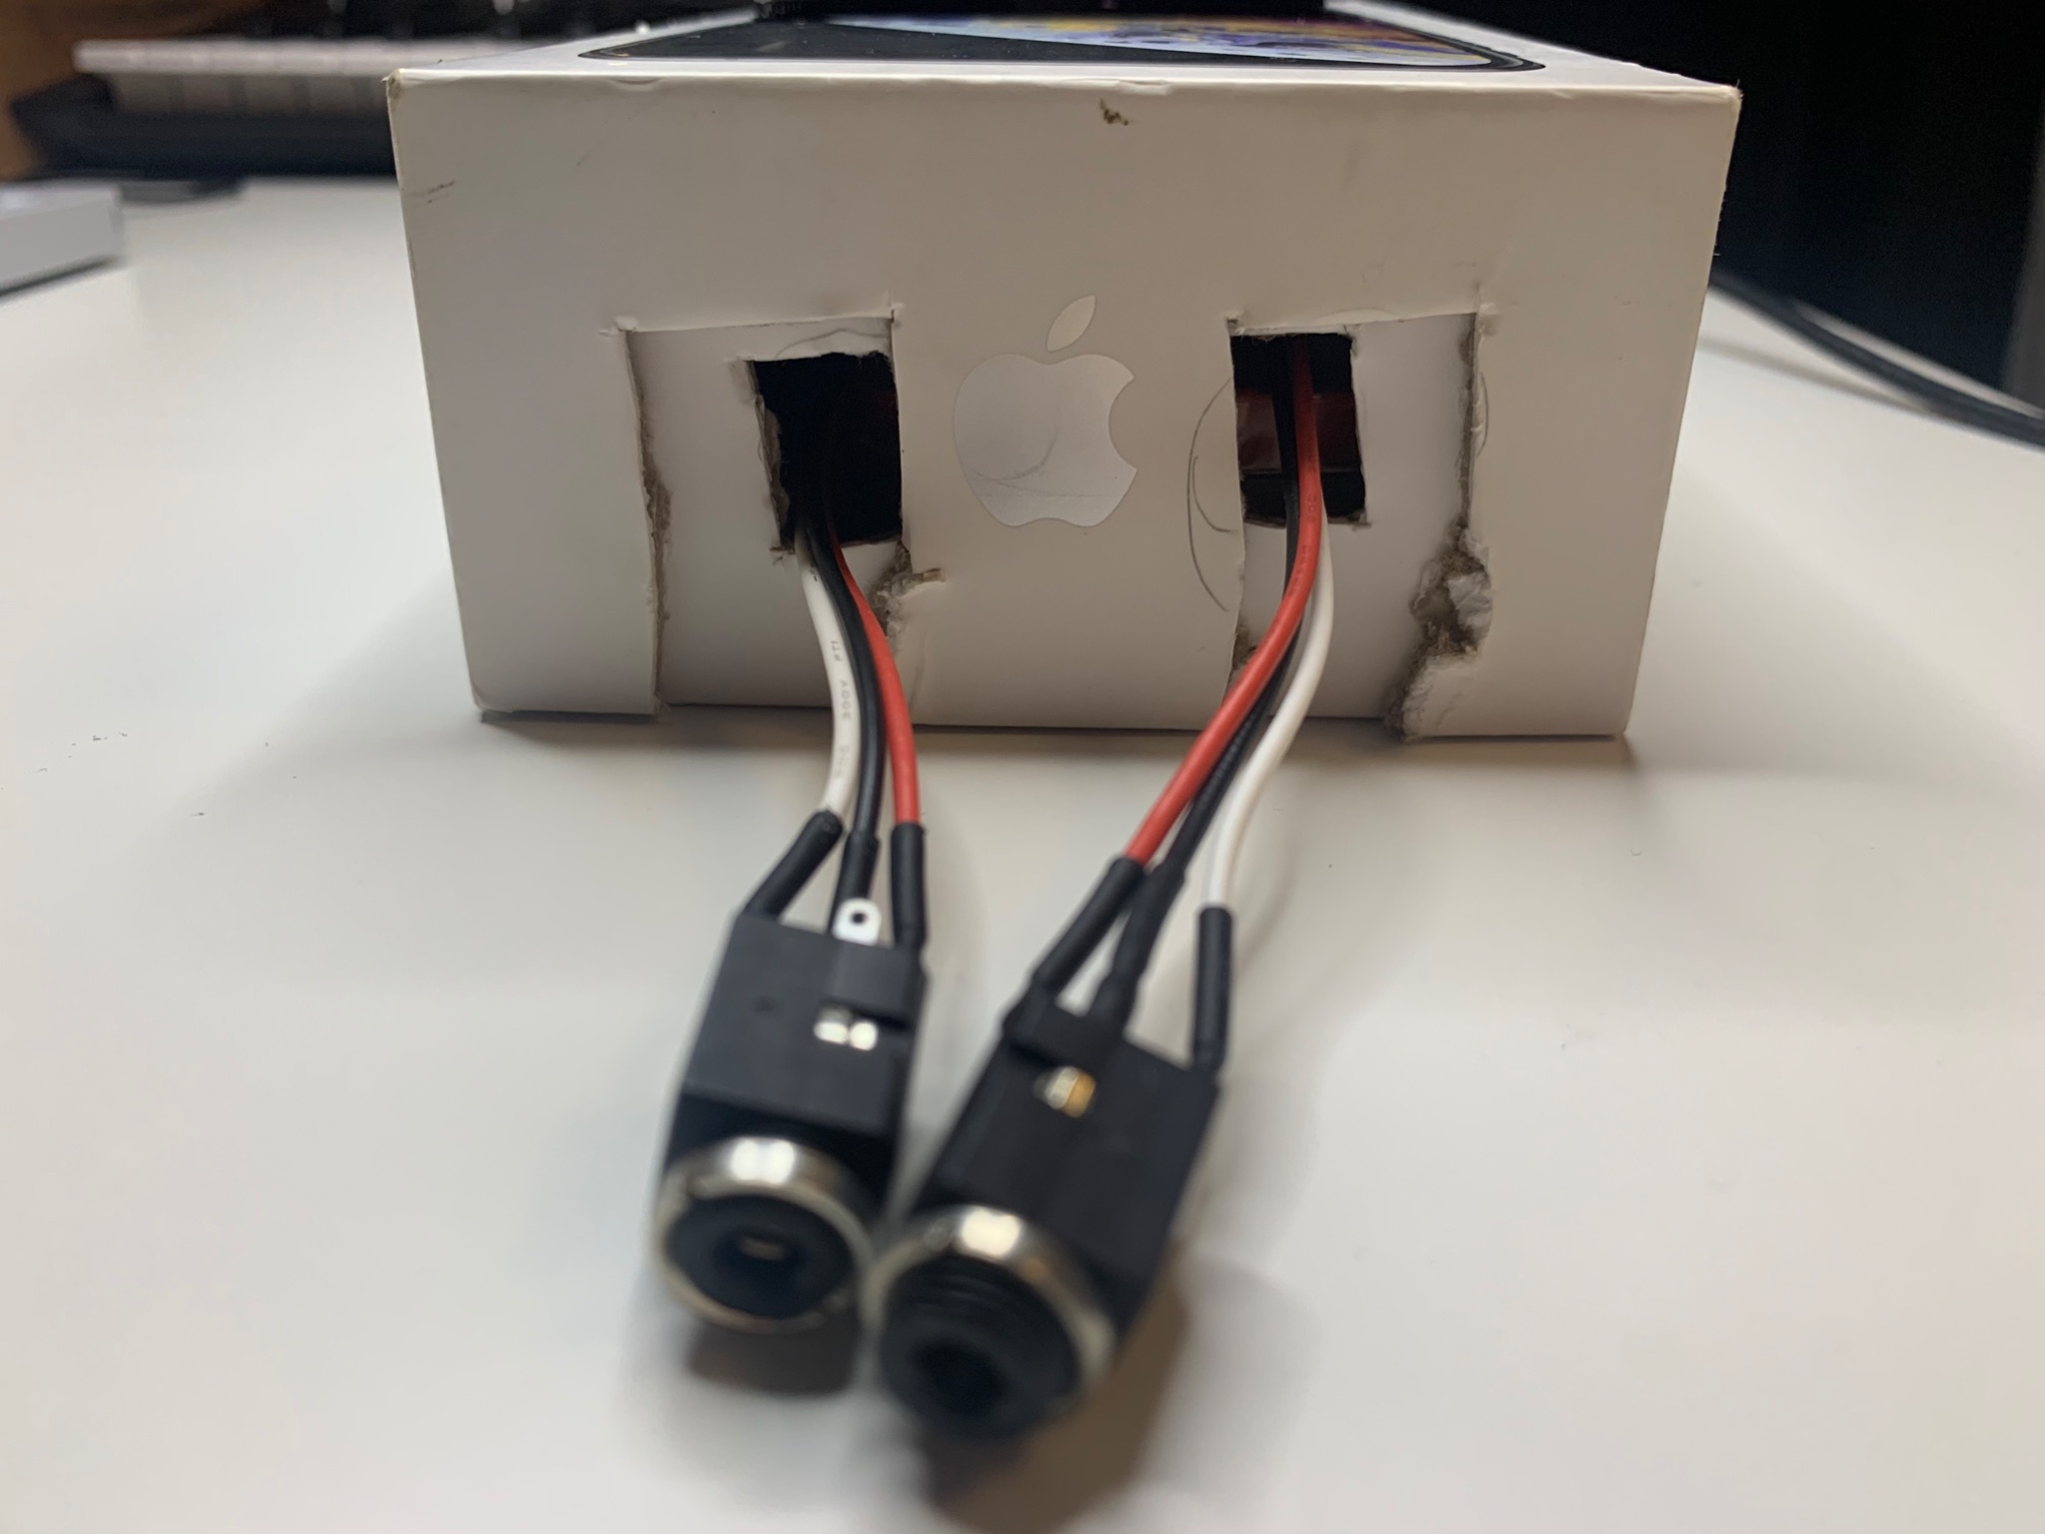
Device Configuration
Input
Output

Slide 7
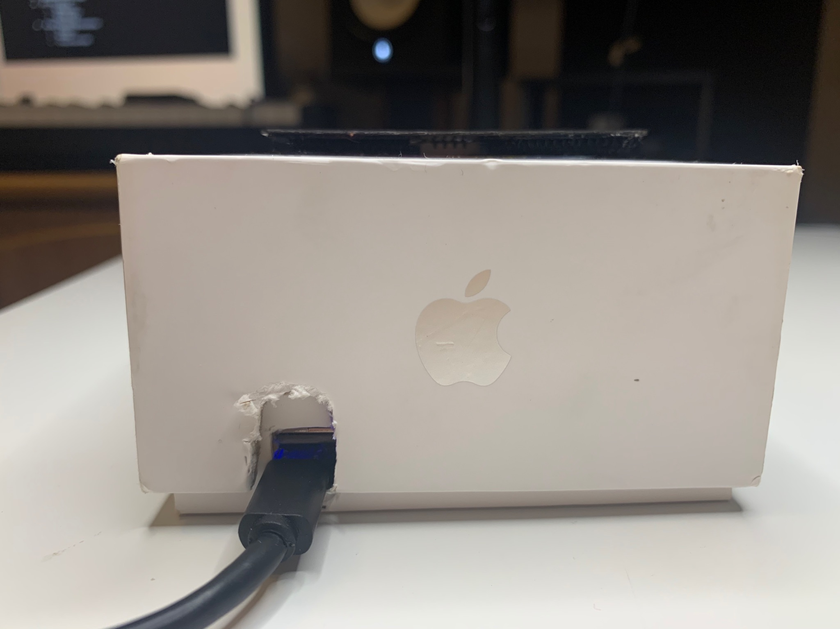
Device Configuration
USB Port

Slide 8
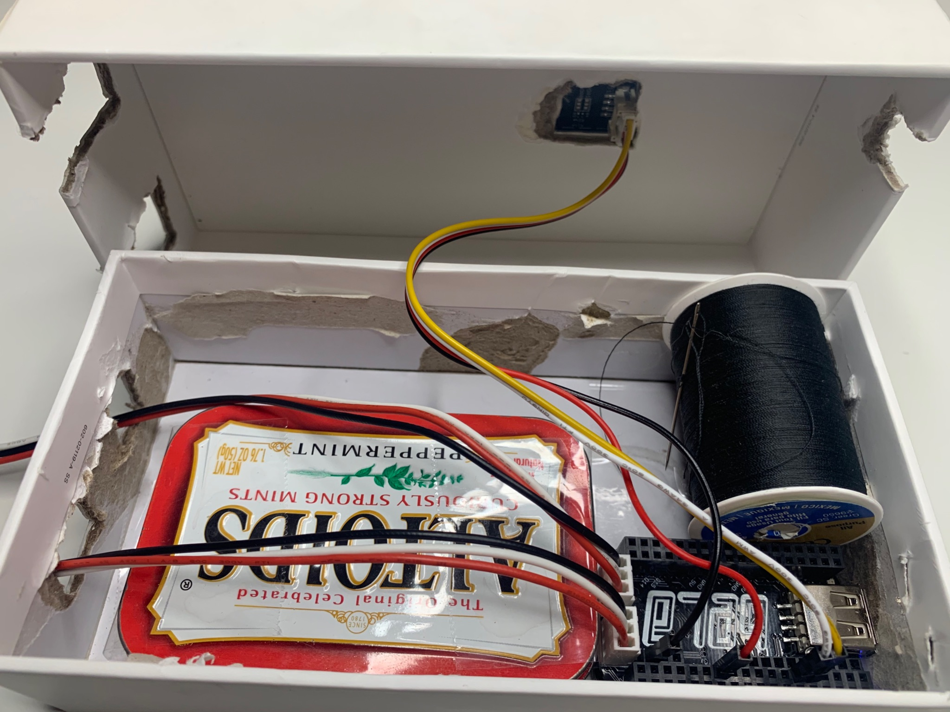
Device Configuration

Slide 9
Demonstration

Slide 10
What Works?
Trill Sensor
GUI Controller
Record and Playback Audio
FFT Pitch Scaling
FFT Robotisation
FFT Whisperisation
Loop Length Manipulation
Reverse Playback
Speed of Playback

Slide 11
What To Improve?
FFT Time Scaling
Speed Up Playback
Standalone Device (Requires More Sensors, Buttons, Pots)
Automatically Return to Play Mode
User Definition of Max Record Time
User Definition of Max Division of Loop Length
Stereo Audio
Fix bugs occasional bugs from Hop Size and FFT Size
Fix bugs occasional segmentation fault from switching between Play Mode and Record Mode
Fix silence introduced after Max Record Time is reached

Slide 12
Acknowledgement
Thank you to Akito von Troyer and Gabriel Ball for their guidance and patient assistance in helping me problem solve through the creation of this program.
Thank you to Andrew McPherson and the Augmented Instruments Laboratory at Queen Mary University of London for their thorough Tutorial Series on Bela and Phase Vocoder Techniques. The programs detailed in the Phase Vocoder mini-series within these tutorials were the source material for which I built my program around.

Slide 13

Learn More About Bela
Visit https://bela.io

Slide 14
Thank You!

